Slide 1
File I/O and Streams in Java

Slide 2
Introduction
Secondary storage retains its information when a computer is turned off and provides a mechanism for holding information beyond the execution of a program.
Information in secondary storage can be accessed later by the same or a different program. This information resides in secondary memory in the form of files.
This lecture covers how to connect a program to a file, how to store information in that file and how to retrieve that information.

Slide 3
Introduction
Data files
  Can be created, updated, and processed by java programs
  Are used for permanent storage of large amounts of data
    Storage of data in variables and arrays is only temporary
    Files are used for Permanent retention of data

Slide 4
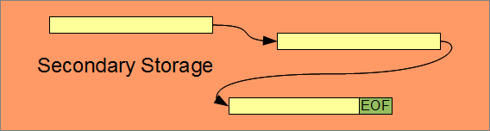
Files
A file is a named area of secondary storage.
The file may be fragmented; that is, it may consist of several parts stored at different non-contiguous locations in secondary memory. Operating system controls file fragmentation
What happens when an application opens or closes a file? Every OS has its own EOF character and, for text files, its own EOL character(s).

Slide 5
The Data Hierarchy
Data Hierarchy:
  Bit – smallest data item
    Value of 0 or 1
  Byte – 8 bits
    Used to store a character
      Decimal digits, letters, and special symbols
  Field – group of characters conveying meaning
    Example: your name
  Record – group of related fields
    Represented by a struct or a class
    Example: In a payroll system, a record for a particular employee that contained his/her identification number, name, address, etc.

Slide 6
The Data Hierarchy
Data Hierarchy (continued):
  File – group of related records
    Example: payroll file
  Database – group of related files
Sally
Black
Tom
Blue
Judy
Green
File
Iris
Orange
Randy
Red
Judy
Green
Record
Judy
Field
01001010
Byte (ASCII character J)
1
Bit

Slide 7
File Formats
A file holds information in either of two formats:
  text - readable and editable data
  binary - executable program code (beyond the scope of these notes)
Data stored in text format is suitable for displaying and modifying through a text editor. Files stored in text format are portable across platforms that share the same character set.
  52 upper and lower case alphabetic characters: A, B, ..., Z, a, b, ..., z
  10 digits: 0, 1, ..., 9
  space
  null, line feed, carriage return, horizontal tab, vertical tab and form feed: \0, \l, \n, \t, \v, \f
  29 graphic characters: ! # % ^ & * ( _ ) - + = ~ [ ] ' | \ ; : " { } , . < > / ?

Slide 8
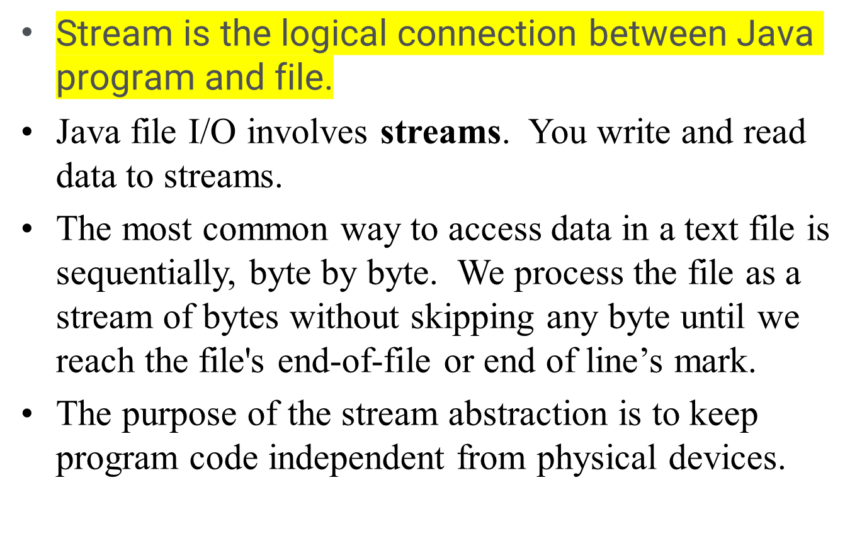
Streams

Slide 9
Types of Streams
There are 2 kinds of streams
  character streams
  byte streams
Three stream objects are automatically created for every application: System.in, System.out, and System.err.

Slide 10
Character Streams
Character streams create text files.
These are files designed to be read with a text editor.
Java automatically converts its internal unicode characters to the local machine representation (ASCII in our case).
  Unicode is the universal character encoding used to process, store and facilitate the interchange of text data in any language while ASCII is used for the representation of text such as symbols, letters, digits, etc. in computers.

Slide 11
Byte Streams
Byte streams create binary files.
A binary file essentially contains the memory image of the data. That is, it stores bits as they are in memory.
Binary files are faster to read and write because no translation need take place.
Binary files, however, cannot be read with a text editor.

Slide 12
Text Files
Text files
  Every 8 bits represents a character
  e.g., ‘0’ = 48, ‘1’ = 49
110000
110001
‘0’
‘1’
Binary files
  Includes all other types of files
  e.g., interpret data as a 16 bit short
110001110010₂
3186₁₀

Slide 13
Classes
Java has 6 classes to support stream I/O
File: An object of this class is either a file or a directory.
OutputStream: base class for byte output streams
InputStream: base class for byte input streams

Slide 14
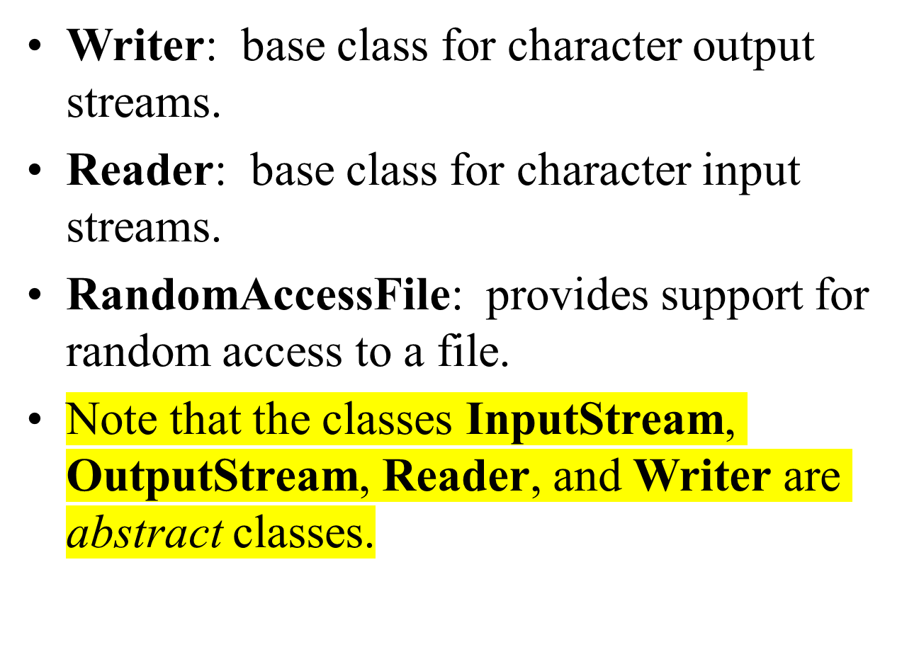

Slide 15
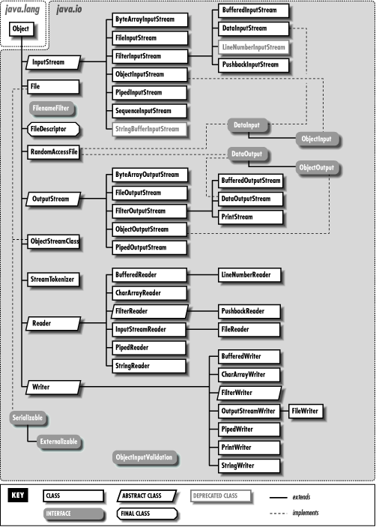

Slide 16
File methods
exists()
isDirectory()
isFile()
canRead()
canWrite()
isHidden()
getName()
getPath()
getAbsolutePath()
getParent()
list()
length()
renameTo( newPath )
delete()
mkdir()
createNewFile()

Slide 17
Reading and Writing a Text File
Lecture Reading Notes

